Slide 1

App Development
using

Slide 2
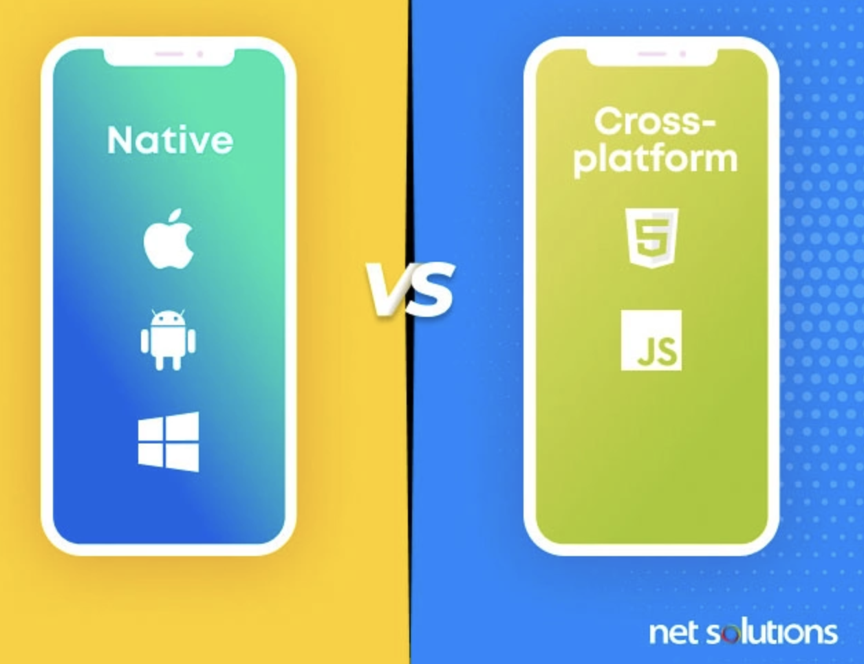
App Development
Its Types:
Native App Development
Cross Platform App Development

Slide 3
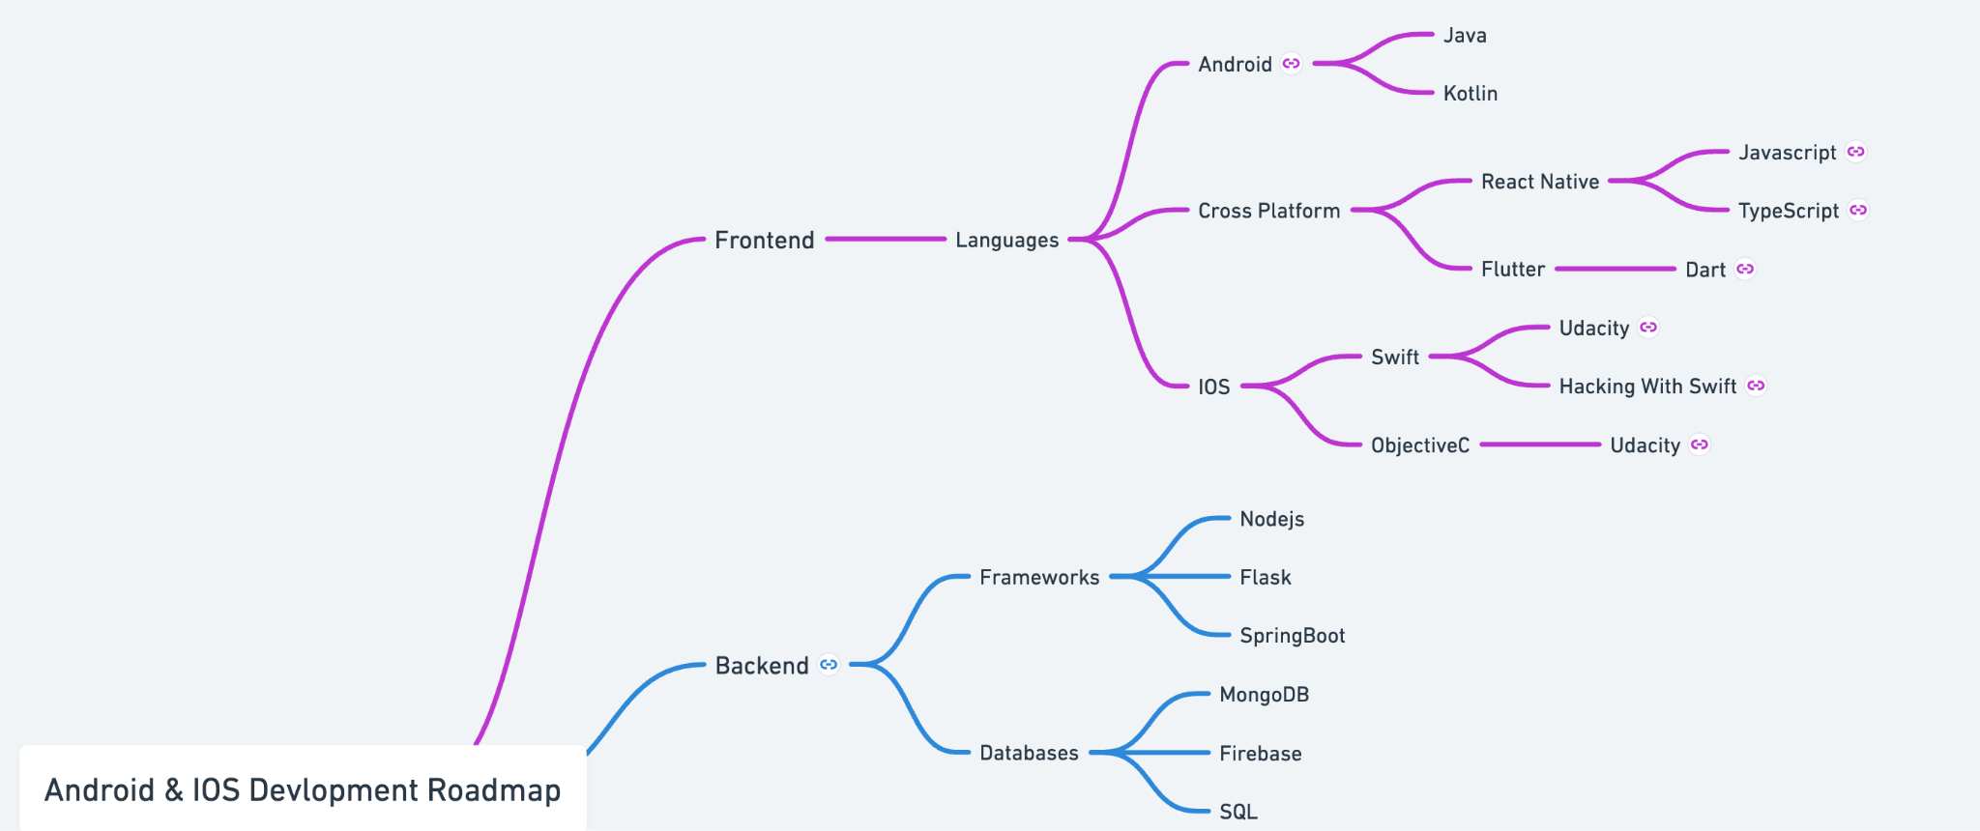
*Roadmap taken from Nishant Chahar youtube video.
Link for full roadmap: https://whimsical.com/android-and-ios-devlopment-roadmap-TH3LmfQWv7FEcTFtEBXpmH

Slide 4
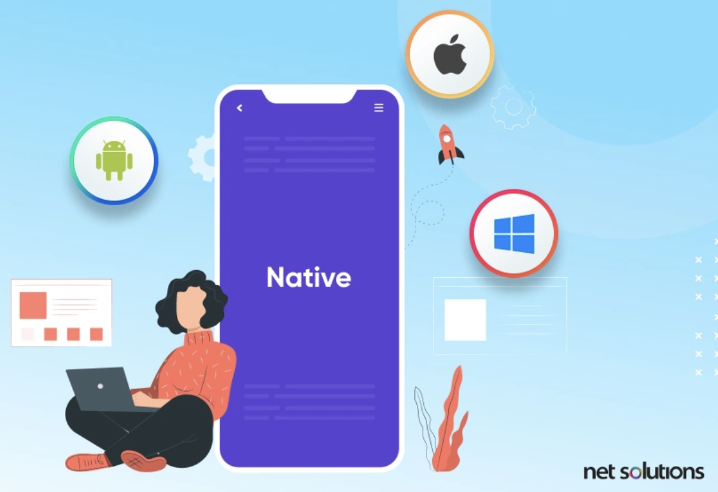
Native App Development
Build a mobile app exclusively for a single platform.
Cons:
Costly
Time Consuming

Slide 5
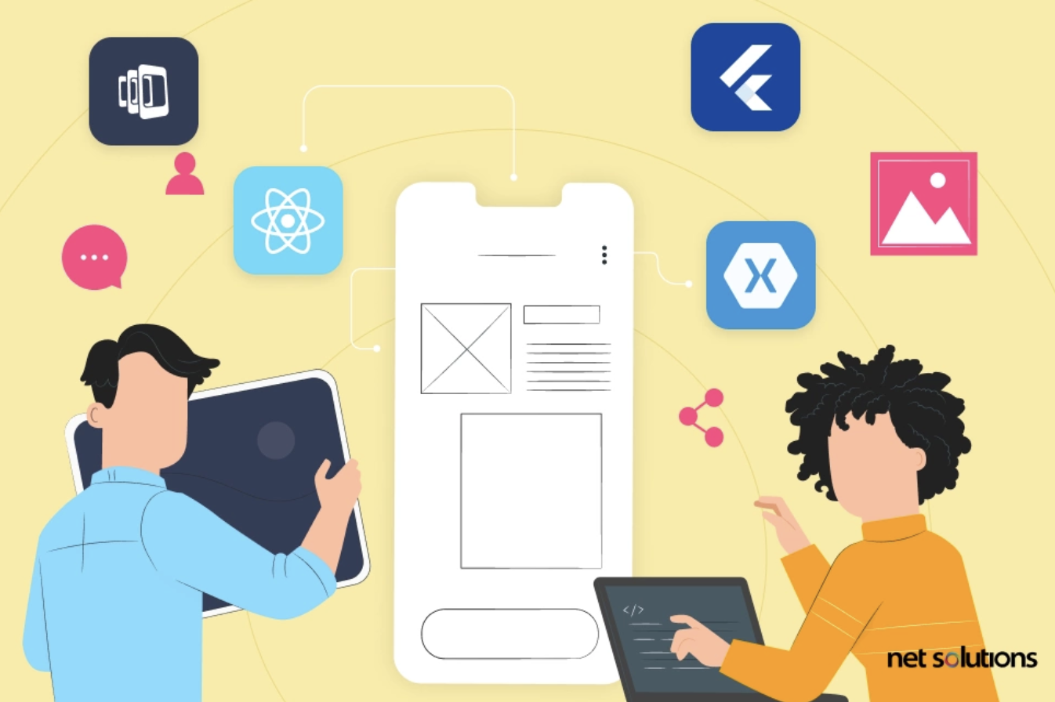
Cross Platform App Development
Build a mobile app exclusively for a different OS using single codebase.
Pros:
Hassle-free & Rapid Development
Great Product Maintenance
Reduced Cost
Code Reusability

Slide 6
Cross Platform App Development Frameworks
Most Popular ones are:
Flutter
React Native

Slide 7
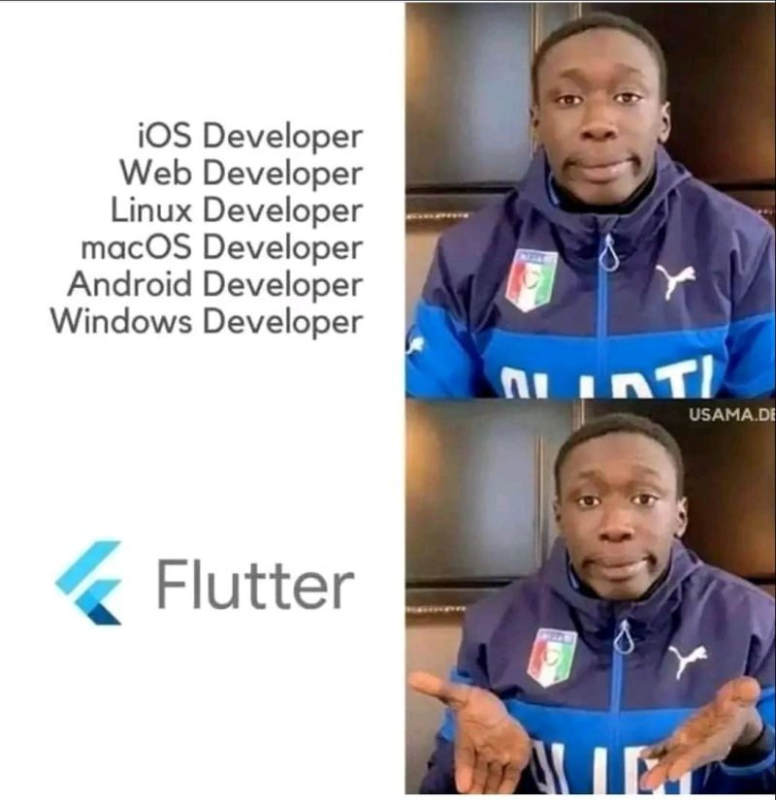
What is Flutter?
Open-source UI (User Interface) framework.
Developed by Google in 2017(released).
Cross-platform support for mobile, web, and desktop.
Single codebase.
Dart (Easy to learn)

Slide 8
Why Flutter over React Native?
React Native does not compile into a native mobile language (Java, Swift, Objective-C).
React Native runs its JavaScript code
Flutter compiles its Dart language into native,
This is why Google’s Flutter is so much faster than React Native.
Hot Reload: Flutter's Hot Reload(instant code changes) is faster and more reliable compared to React Native.
Code Sharing: Flutter allows code sharing across multiple platforms, while React Native primarily focuses on Android and iOS.
UI Components: Flutter provides customizable UI components, while React Native may require additional libraries for consistency.

Slide 9
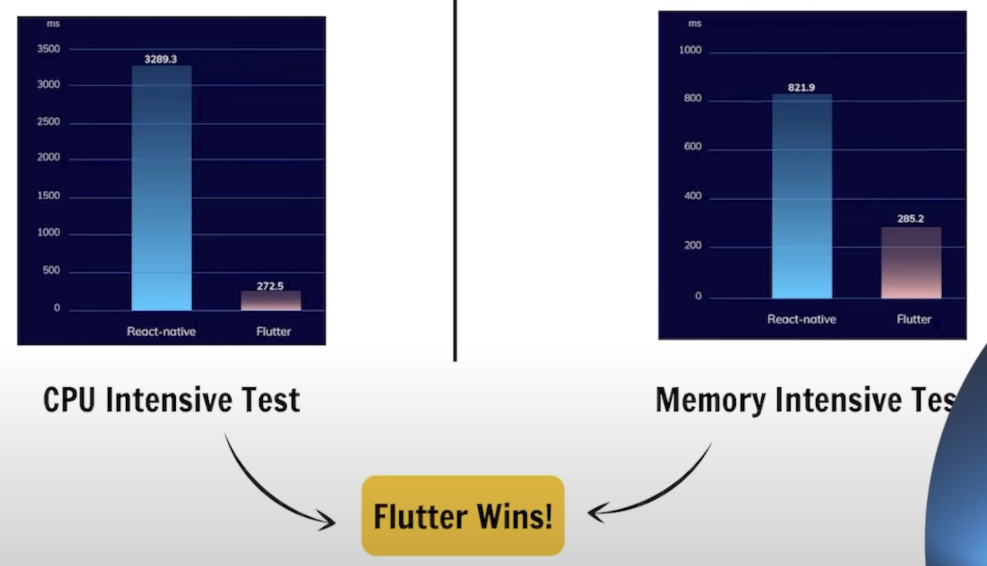

Slide 10
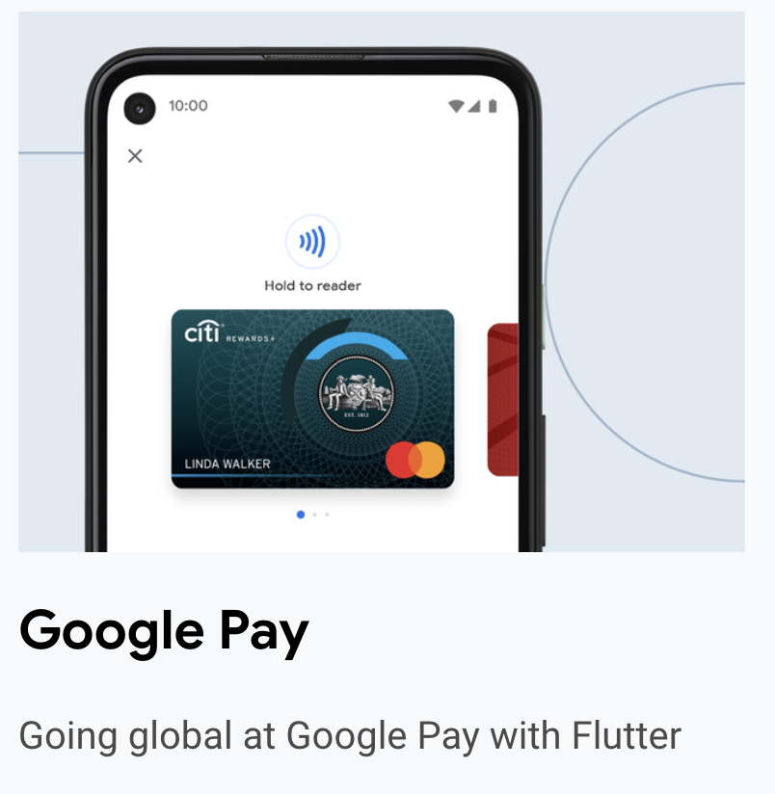
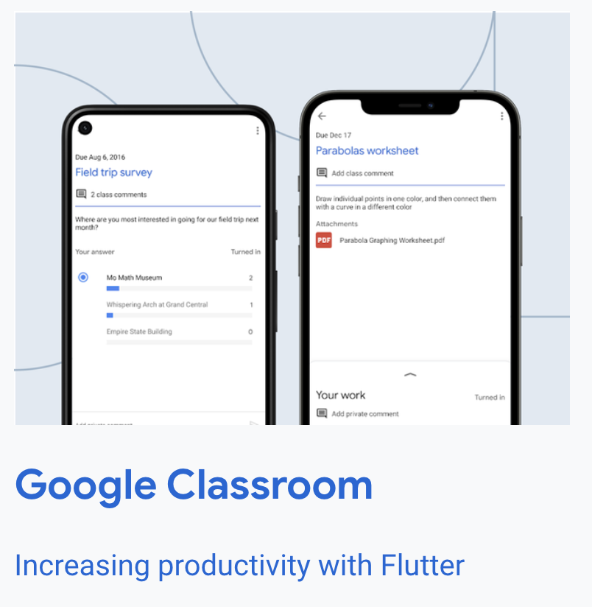
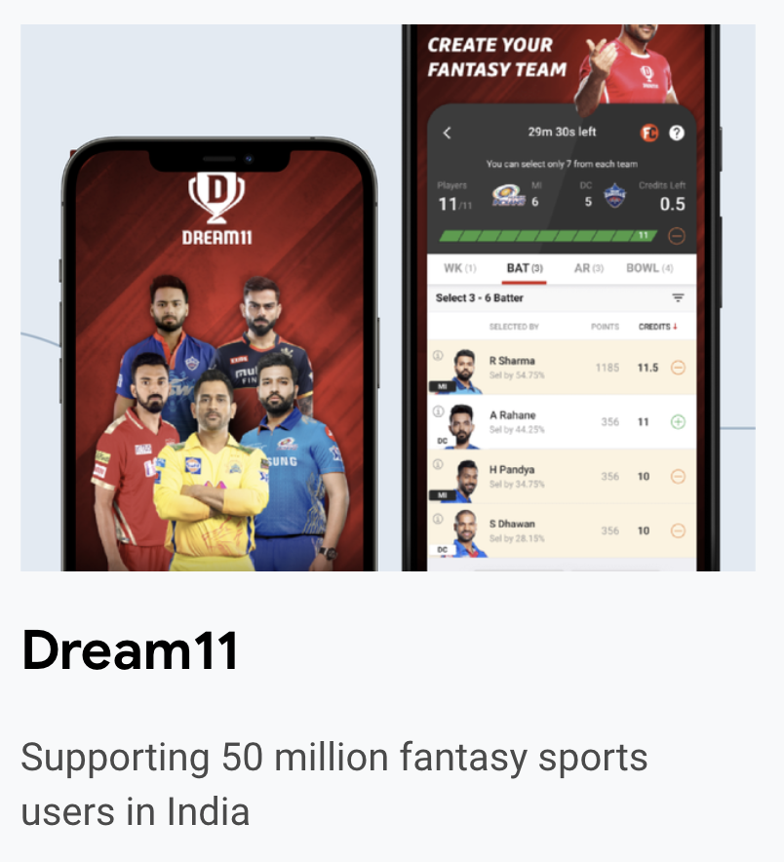
Real World Apps built Using Flutter https://itsallwidgets.com/
Google Pay, Classroom, Dream11

Slide 11
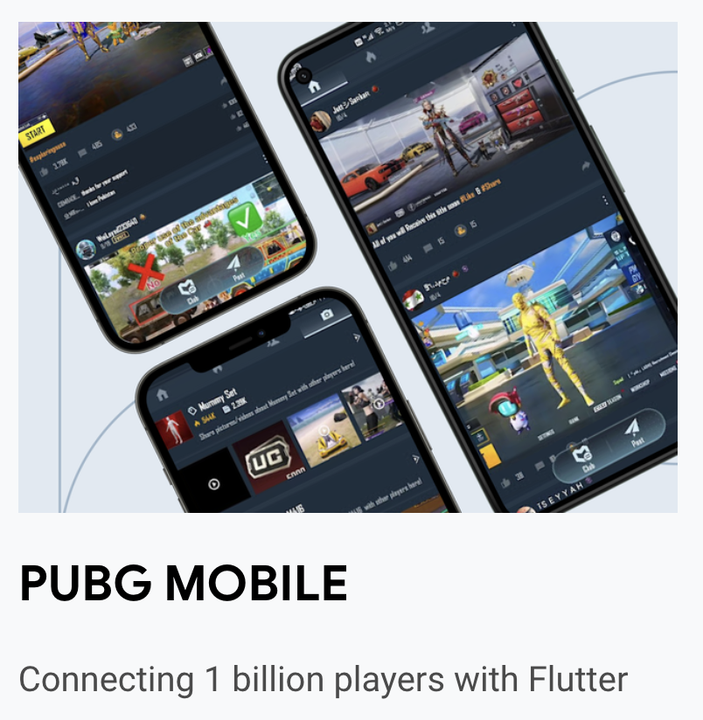
When the PUBG MOBILE team wanted to add a community module to allow players from all over the world to share gameplay clips and more, they turned to Flutter.

Slide 12
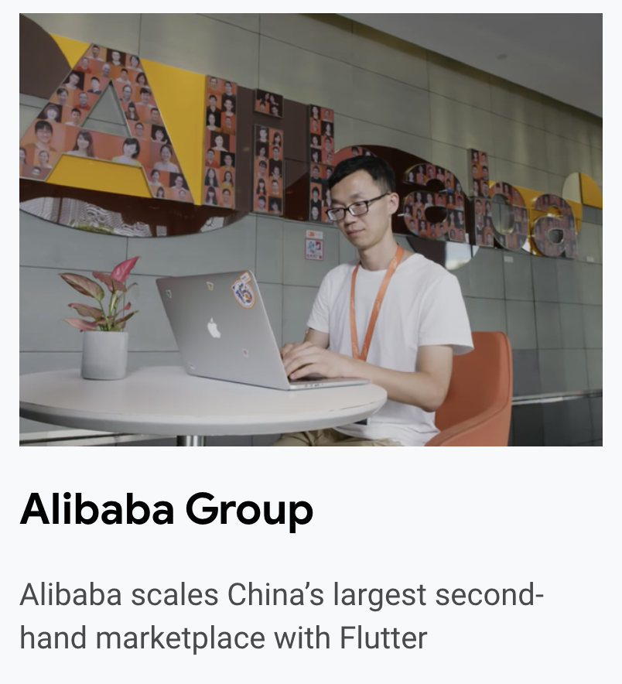
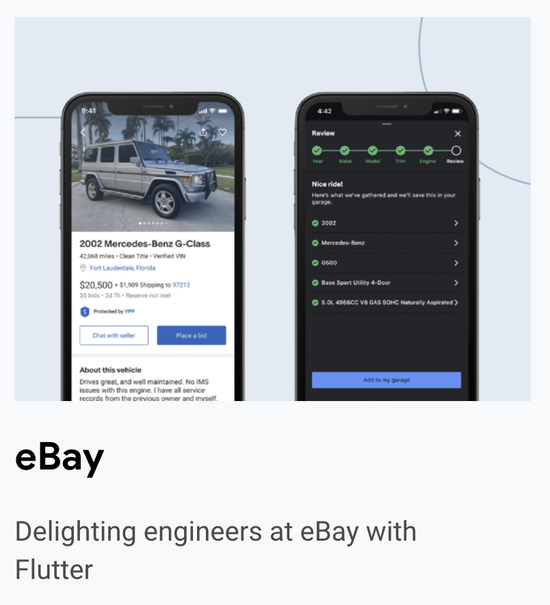
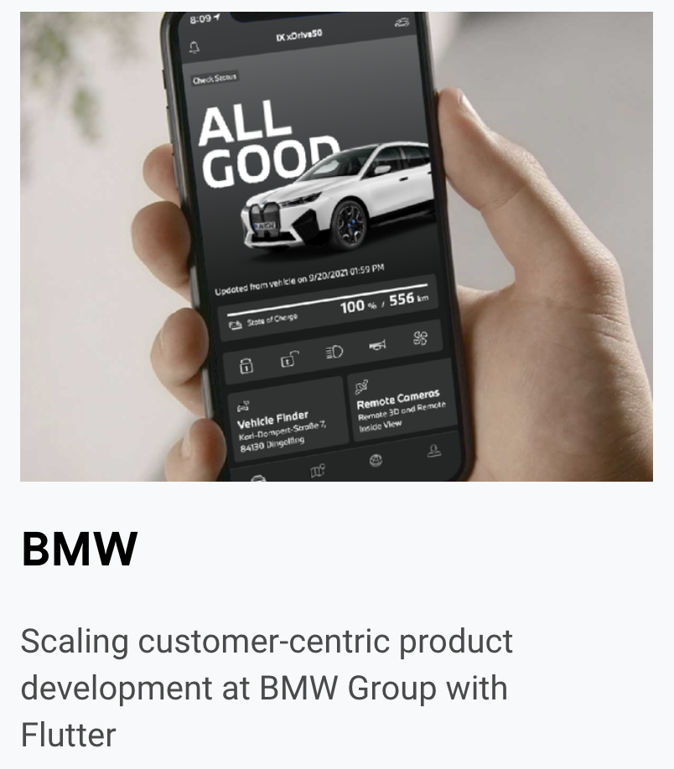
Alibaba.com app, eBay, BMW

Slide 13
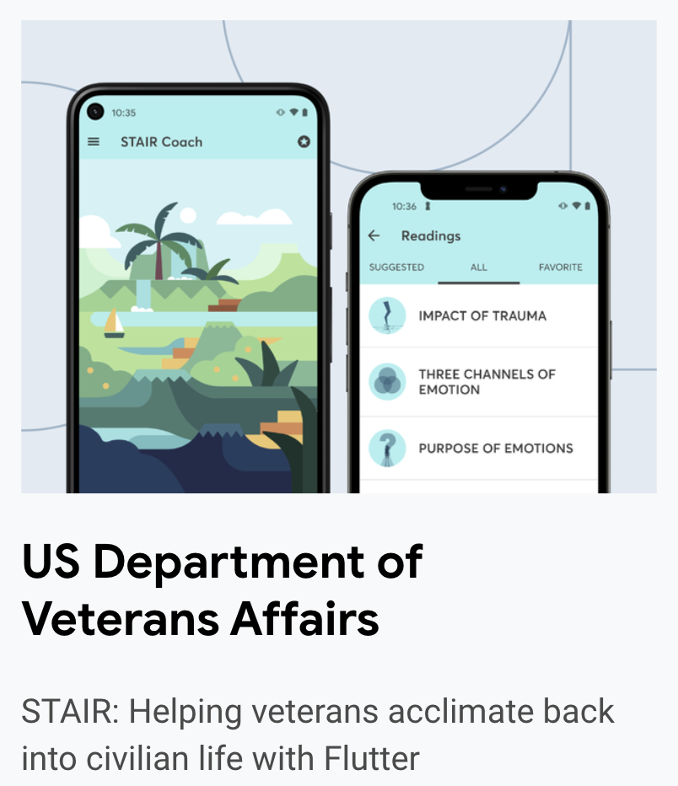
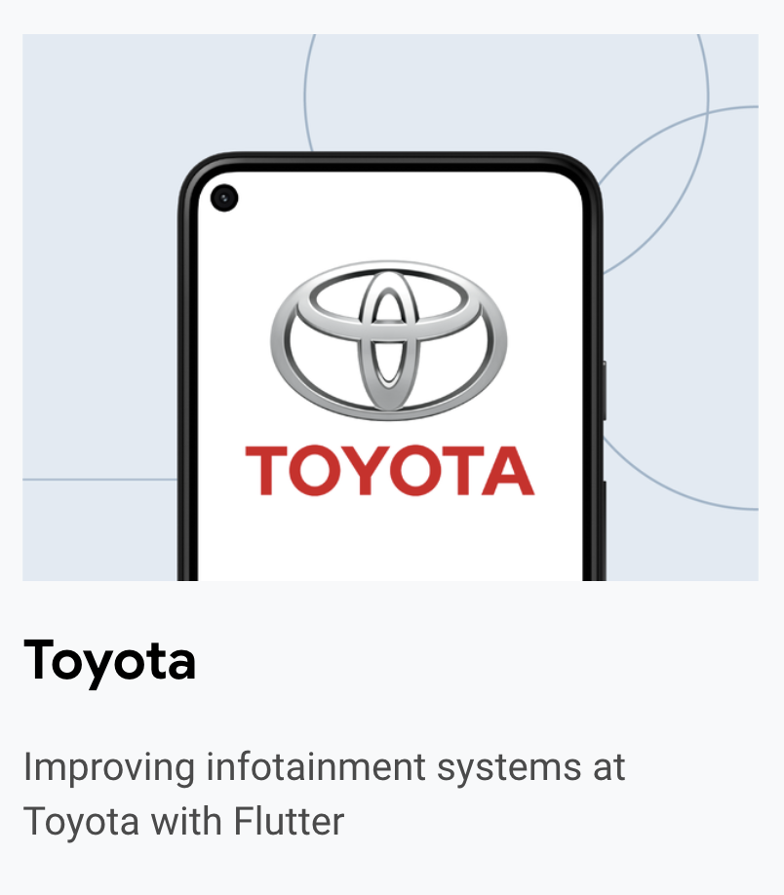

Slide 14
Our Projects:
Transactions App
Catalog App having beautiful and advanced UI
Shop App using Firebase
Meals App using SQLite
Place app using native device features
Instagram Clone
My Github link:
https://github.com/amanat-2003

Slide 15
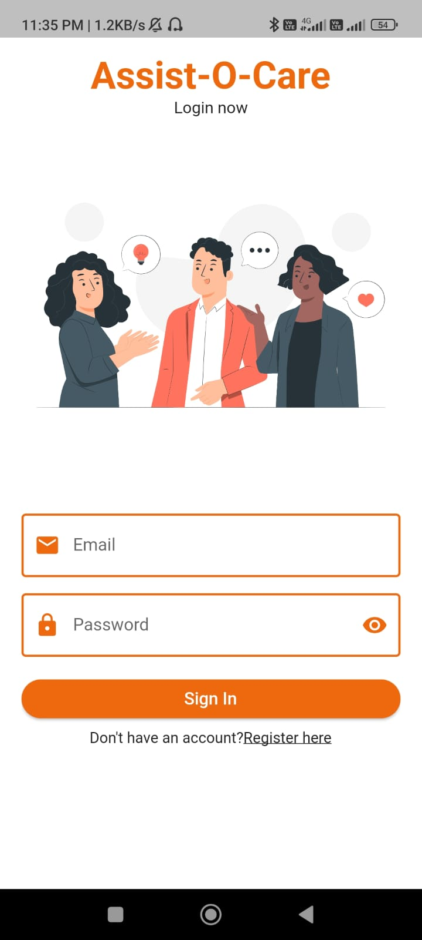
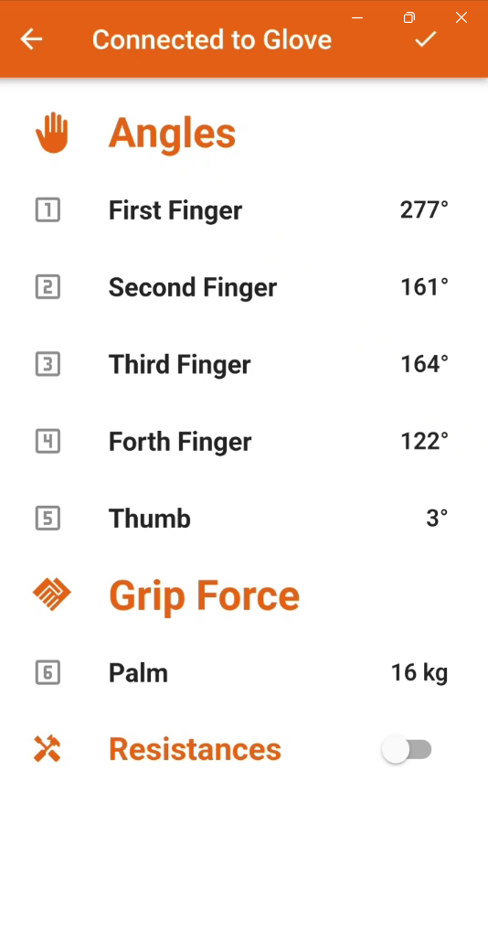
Assist-o-care app
App for motion sensing glove built using flutter.

Slide 16
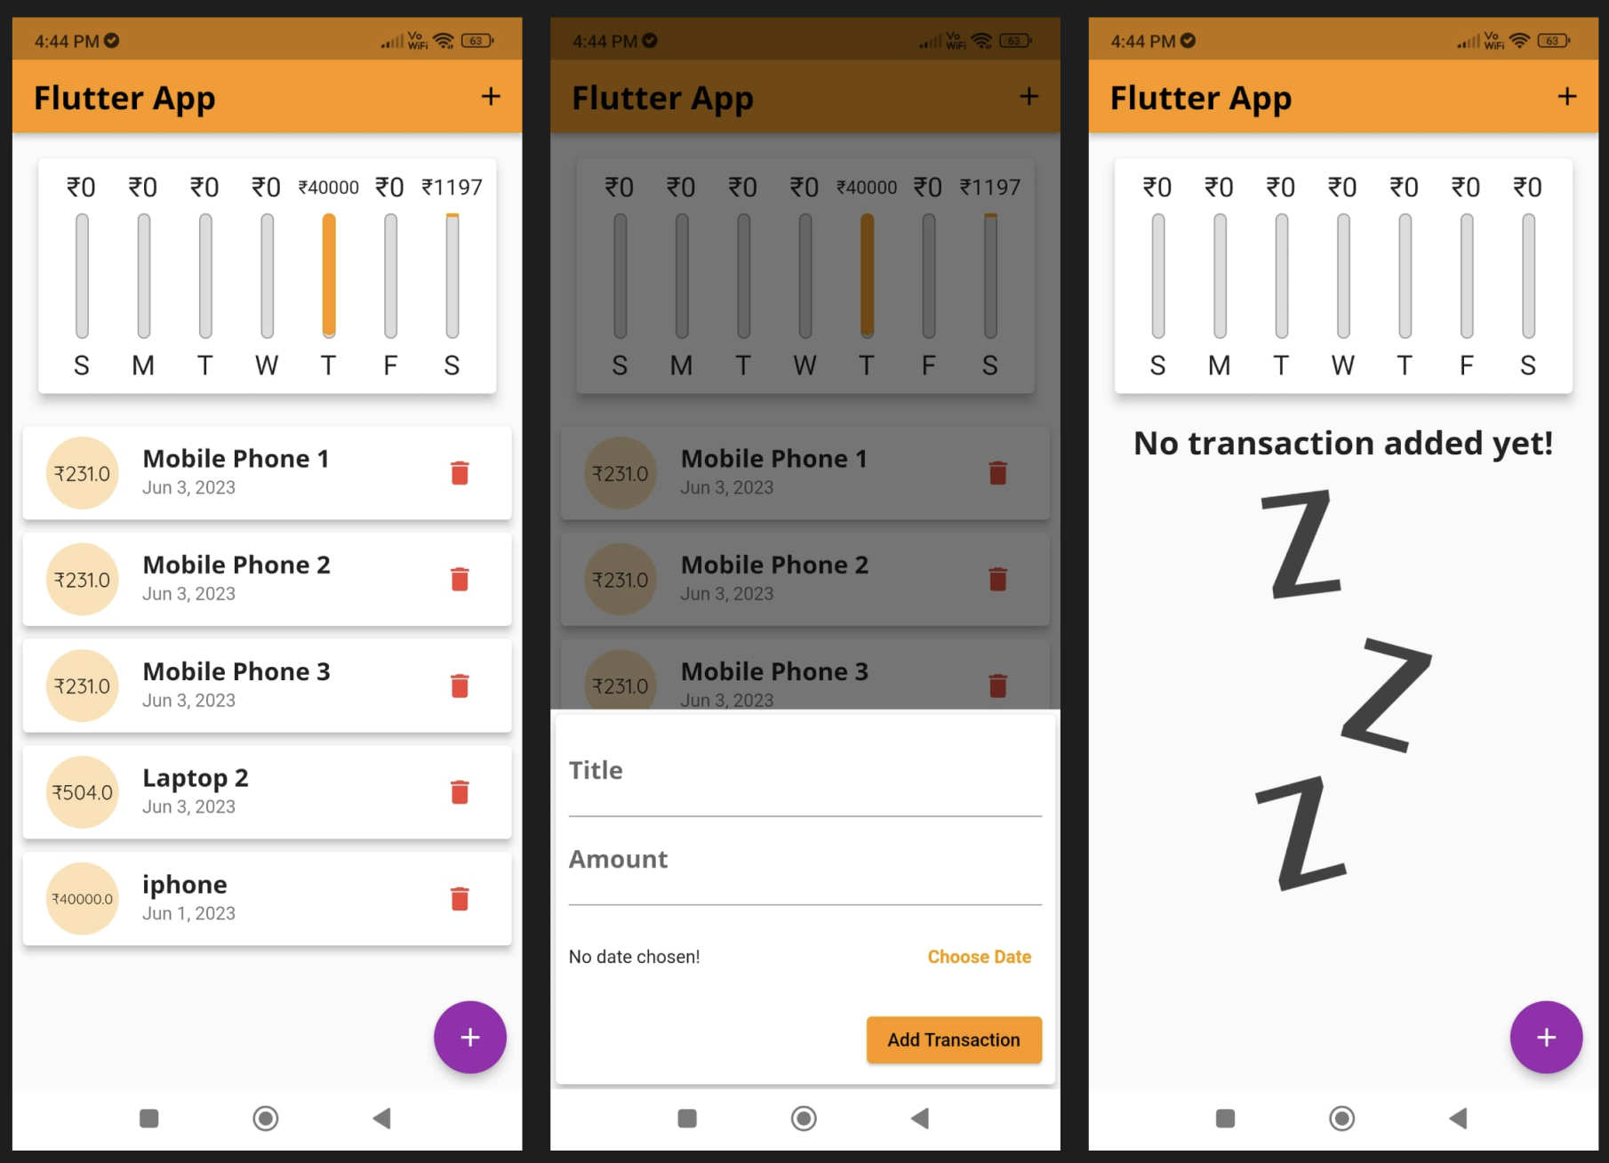
Transactions App

Slide 17
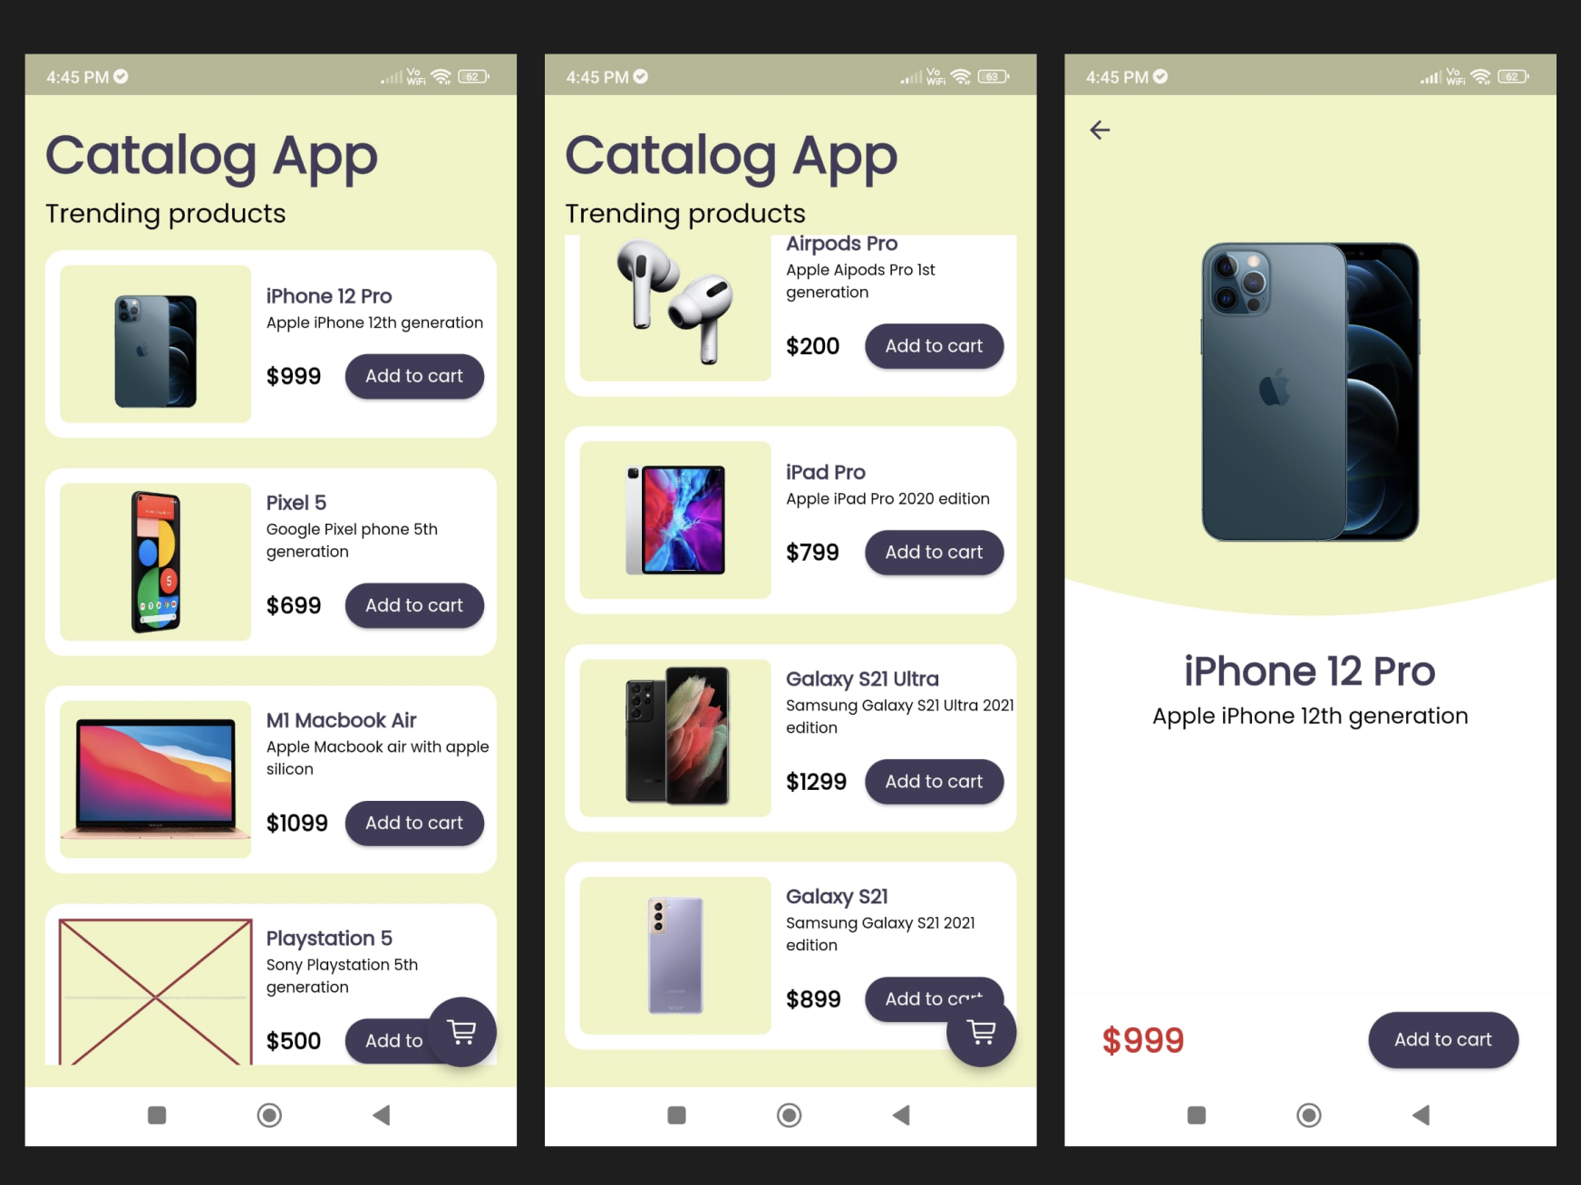
Catalog app using advanced UI

Slide 18
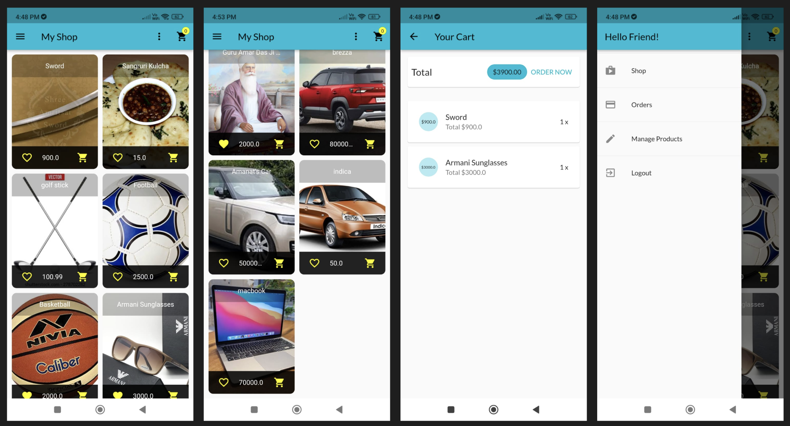
Shop app using firebase

Slide 19
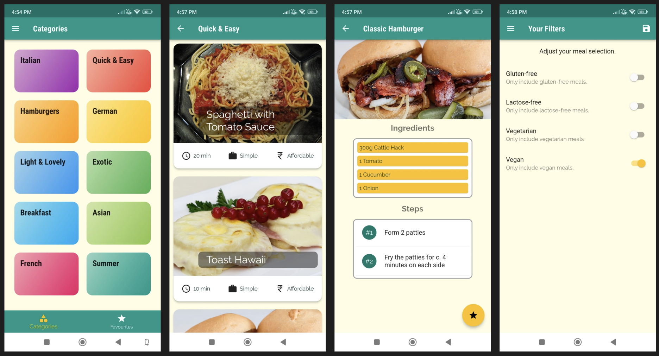
Meals app using SQLite

Slide 20
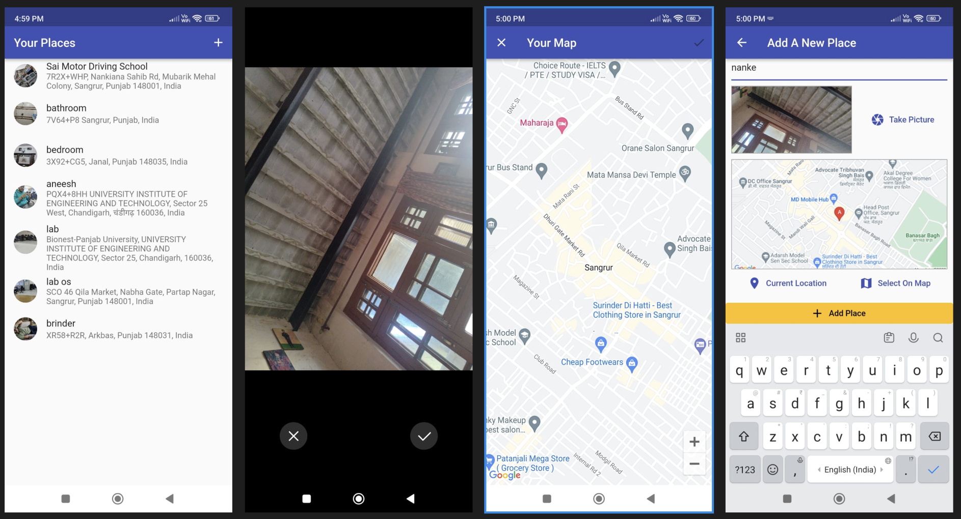
Place app using native device features

Slide 21
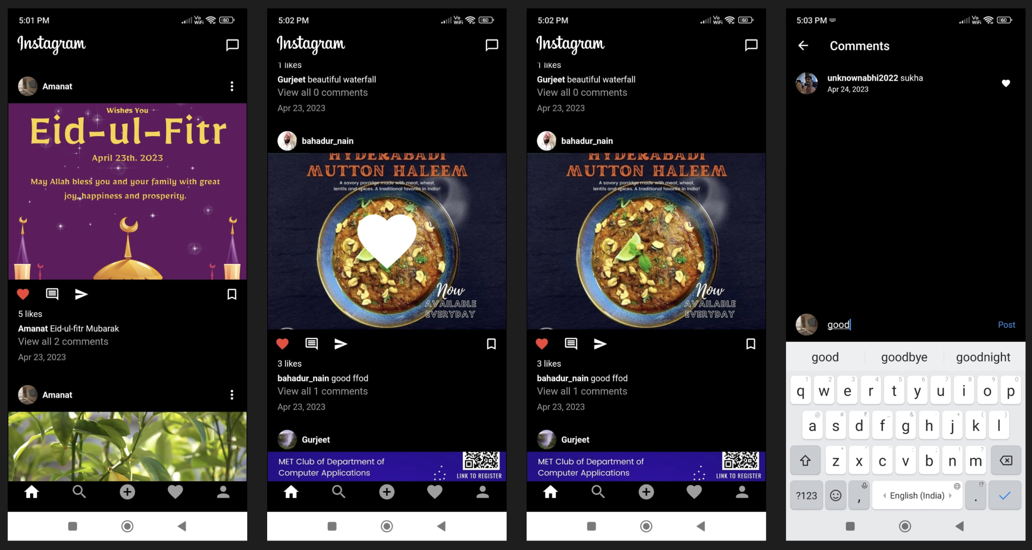
Instagram Clone

Slide 22
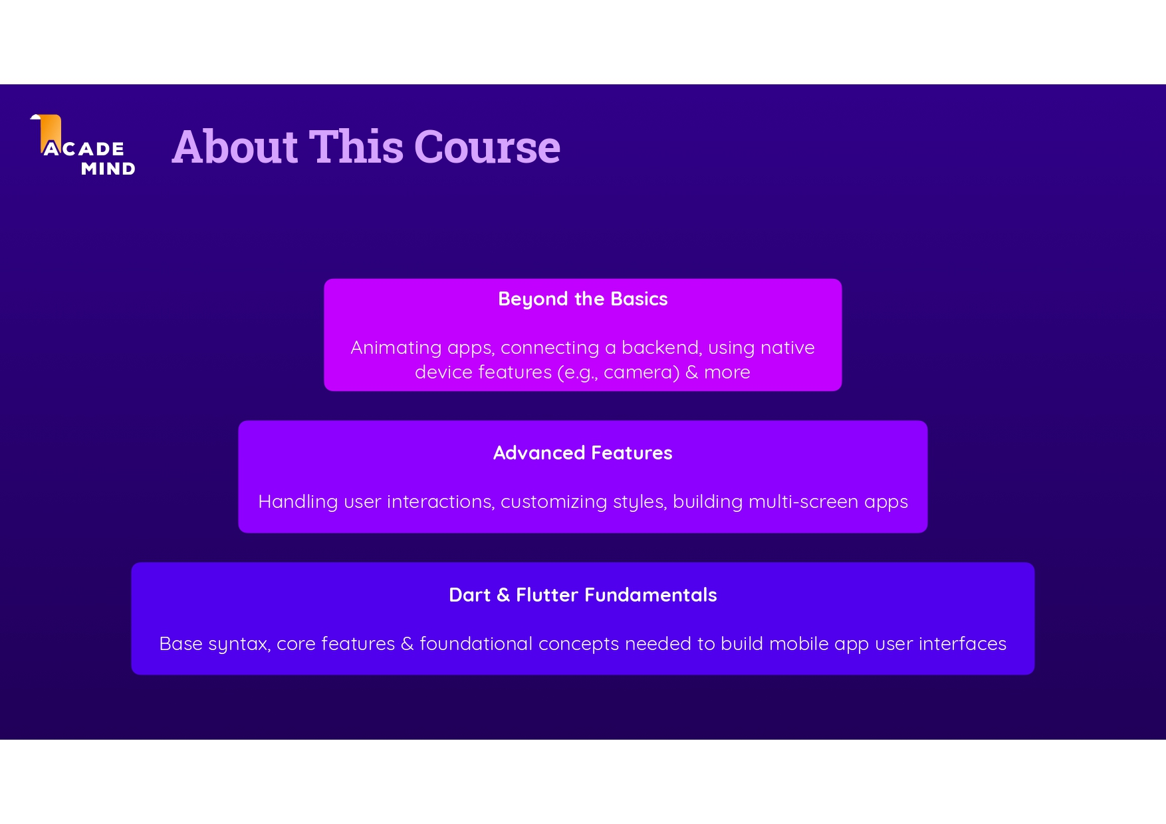

Slide 23
How To Get Most Out Of This Course
Attend the classes regularly
Code Along with us
Practise on your own after the class
Slides & Code would be provided to you
We will take your doubts at the end.
Feel free to ask doubts in the whatsapp group & help your mates

Slide 24
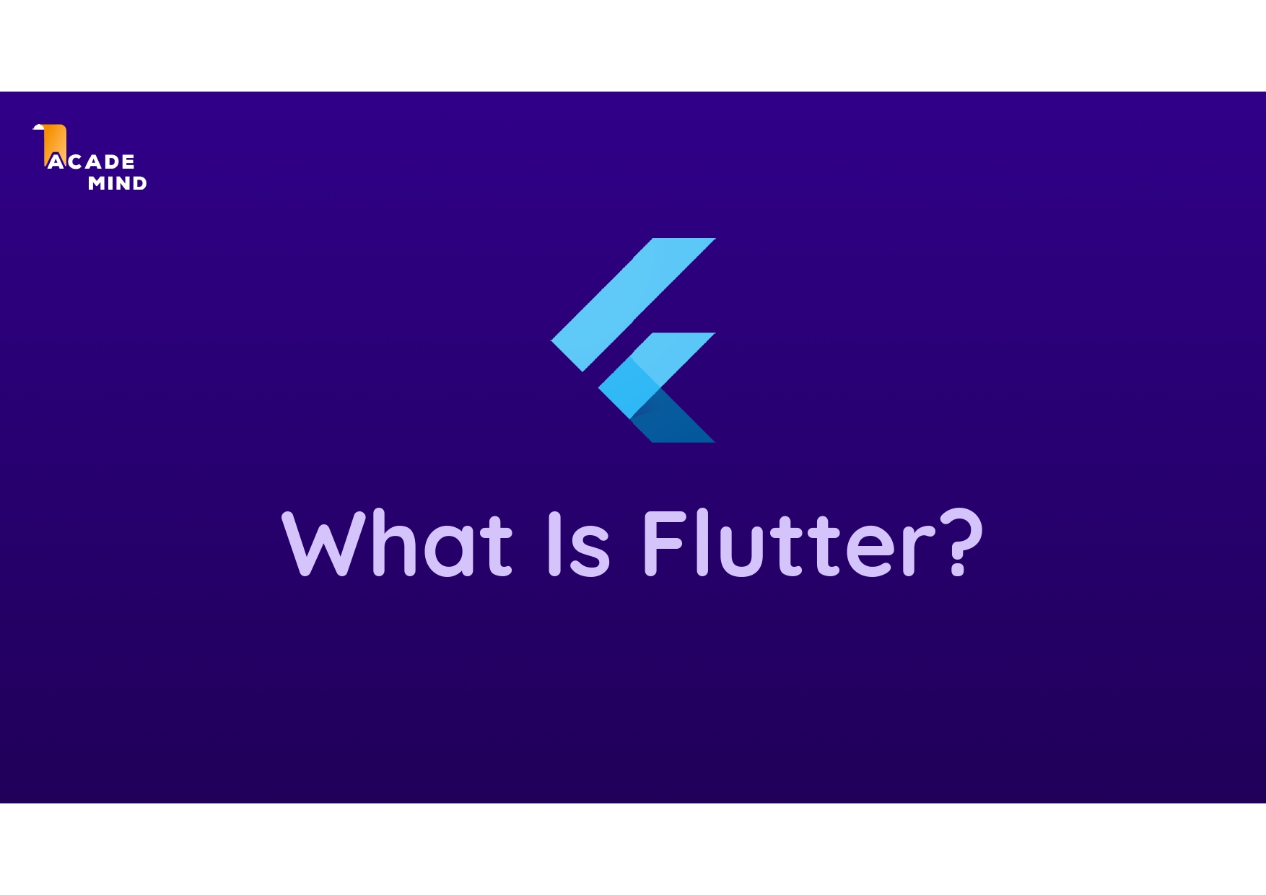

Slide 25
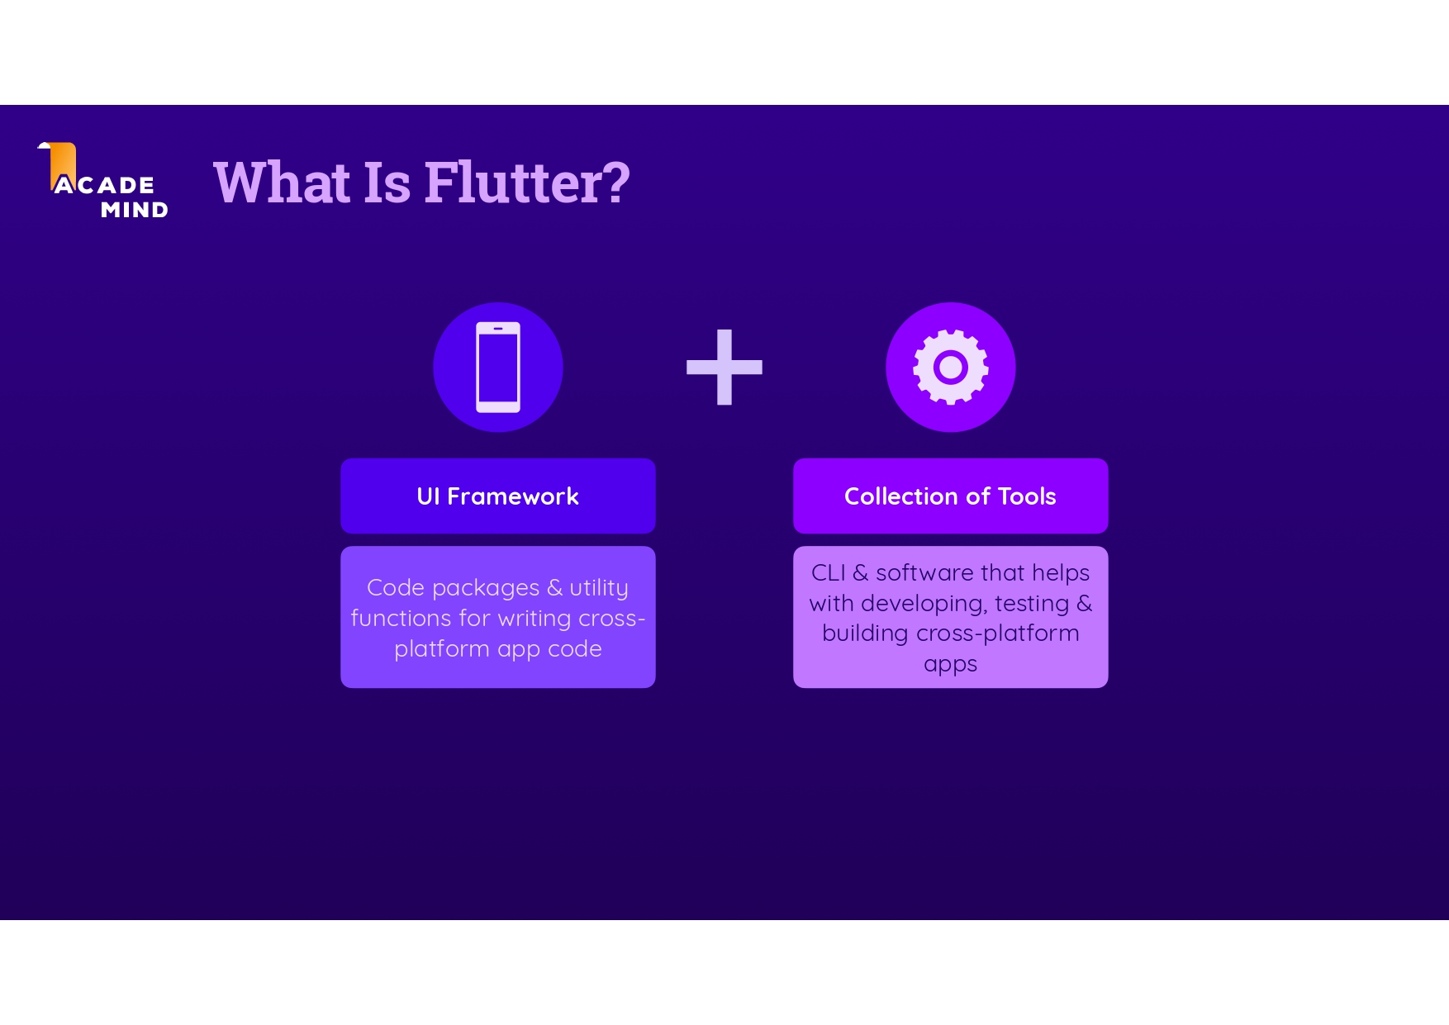

Slide 26
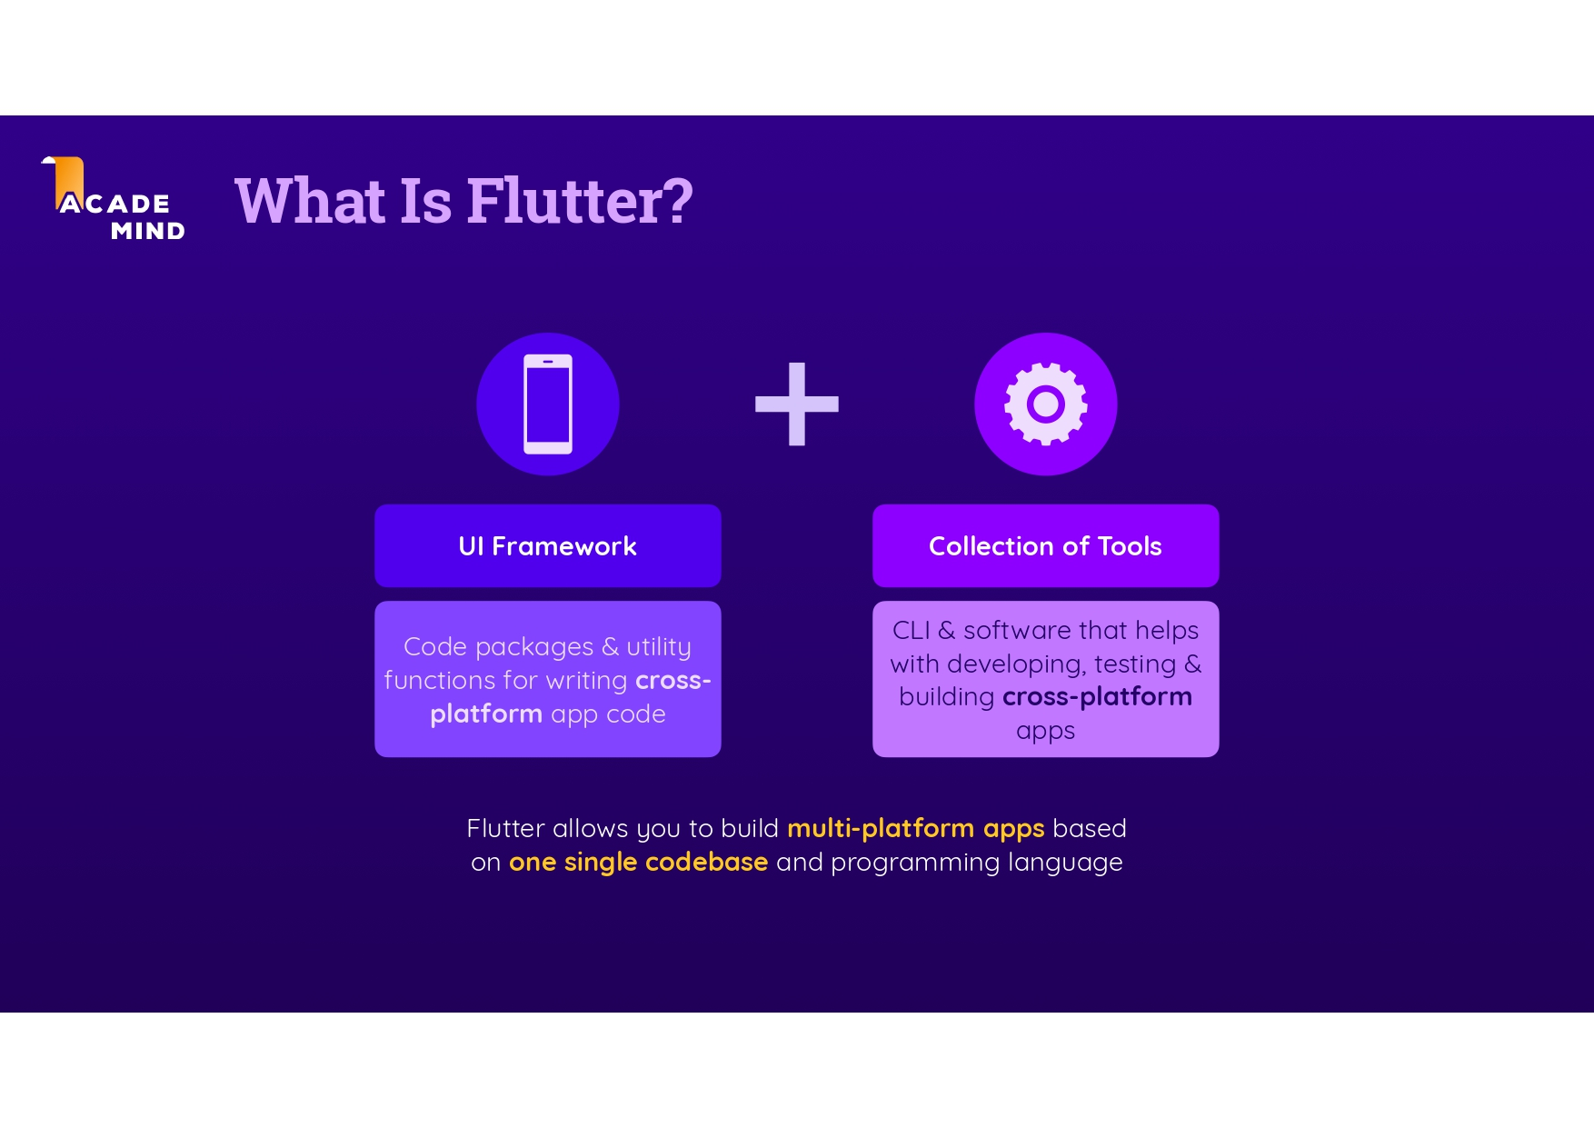

Slide 27
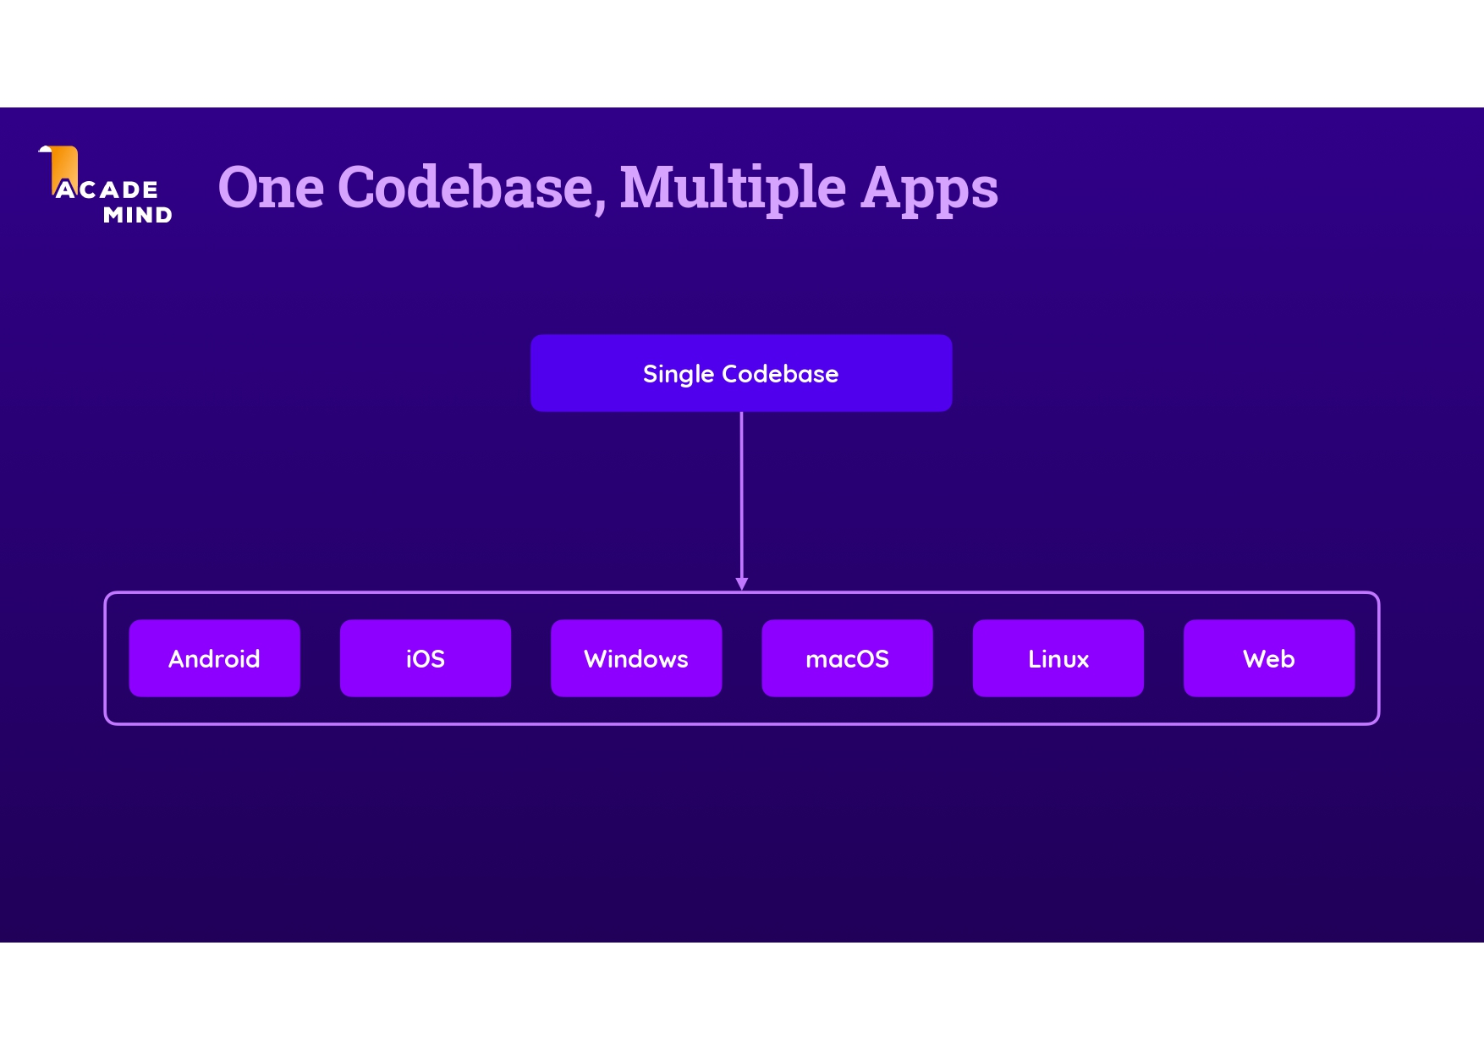

Slide 28
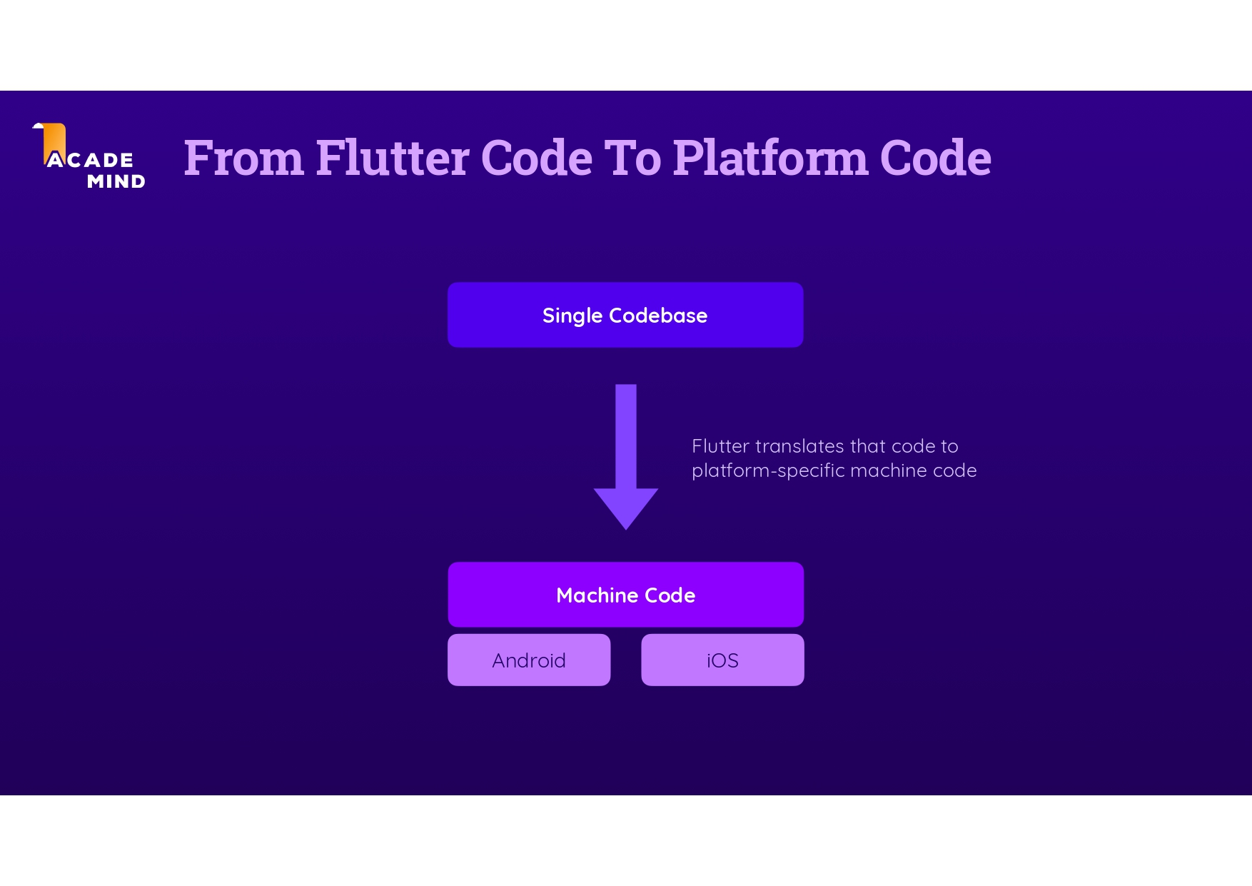

Slide 29
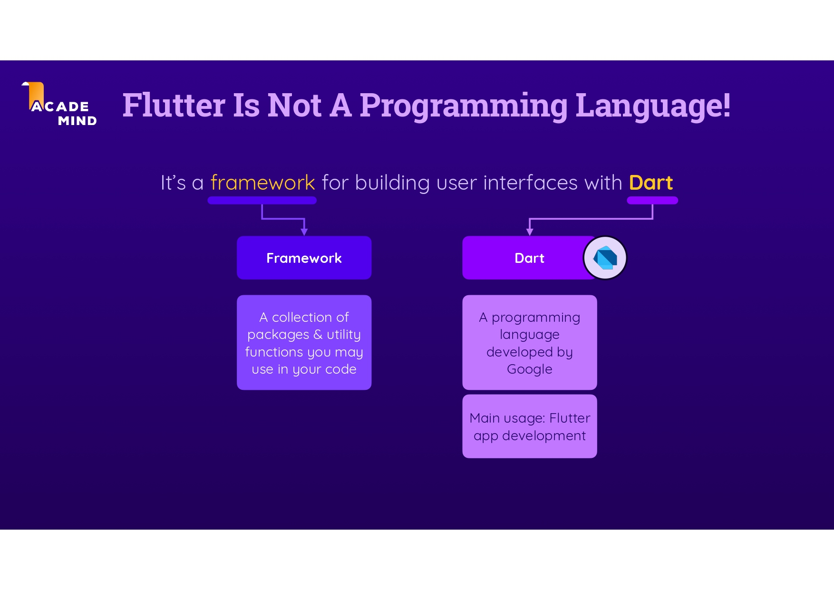

Slide 31
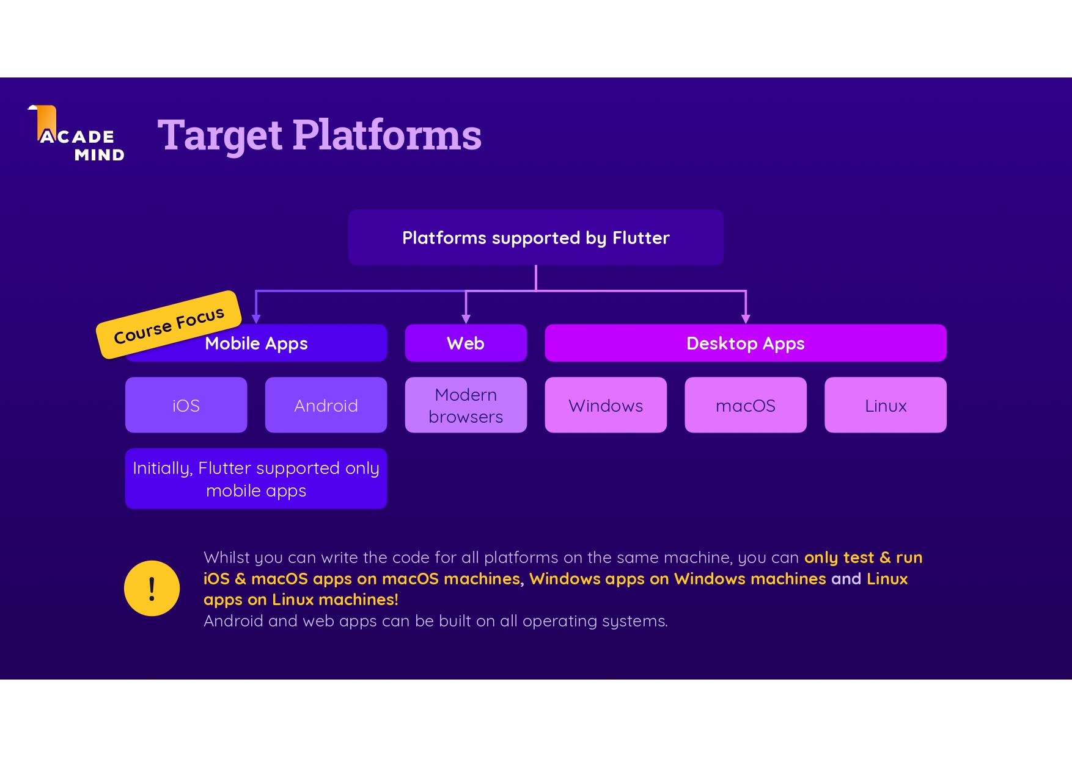

Slide 32
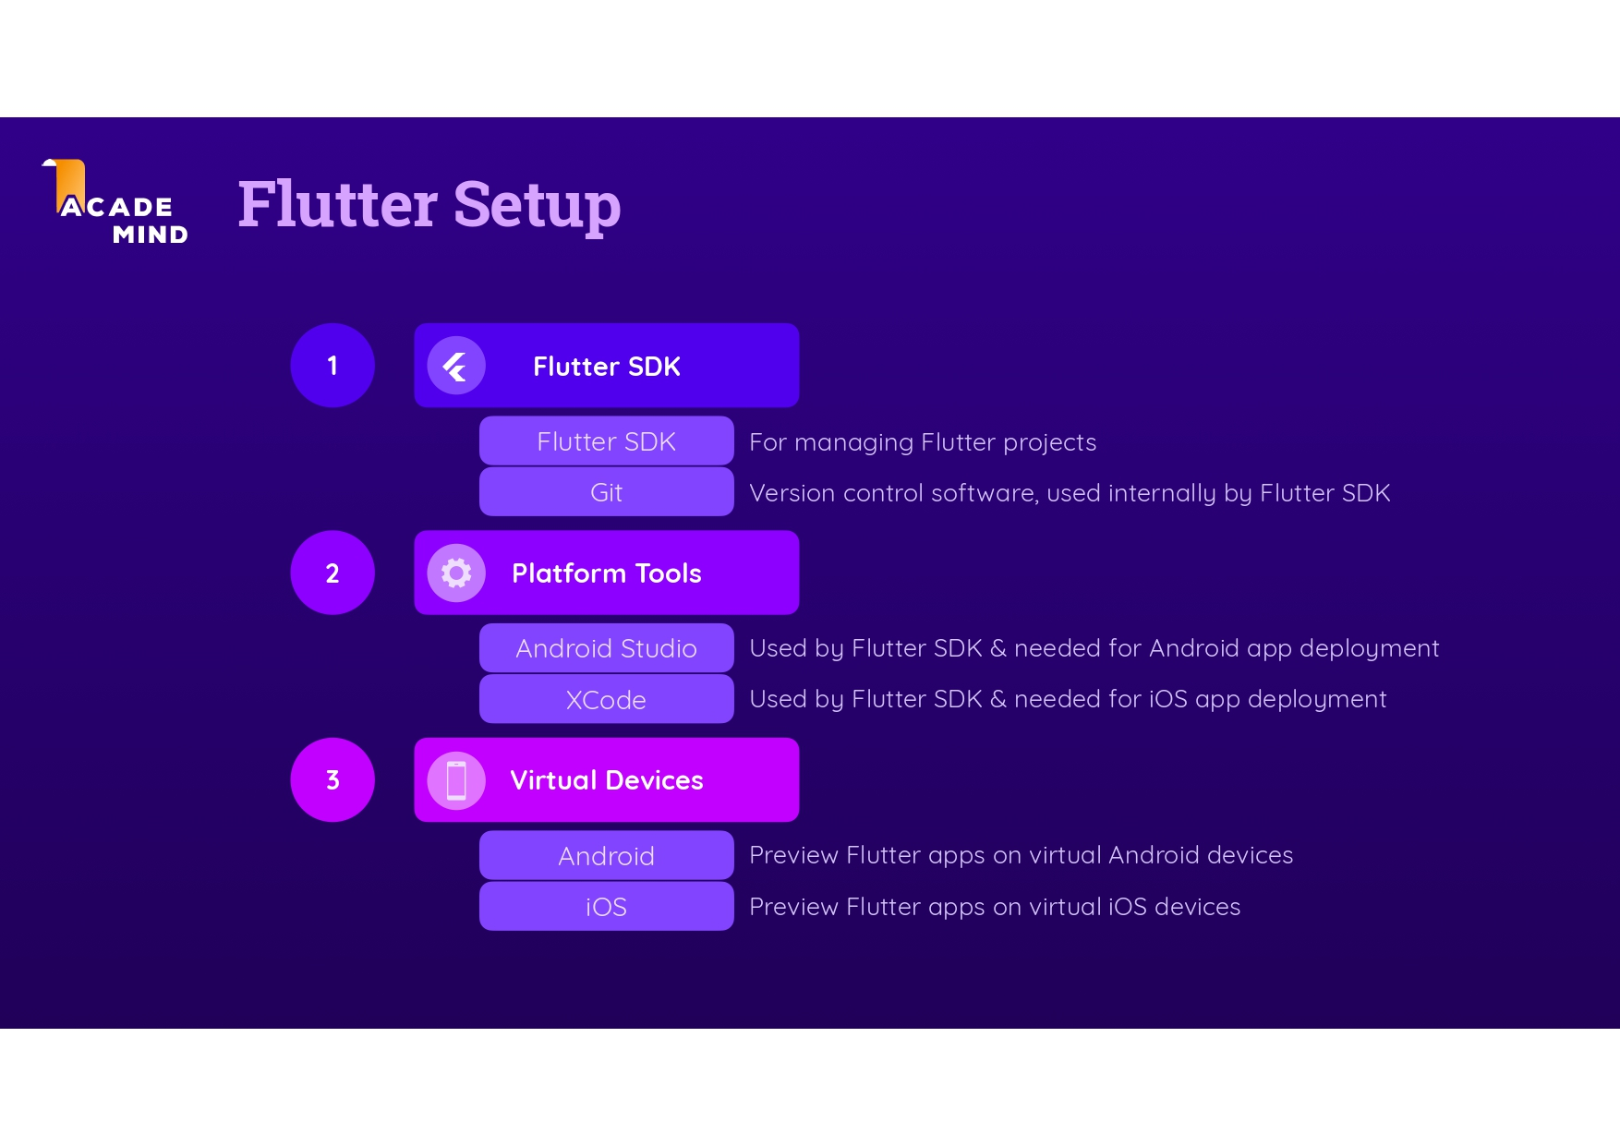

Slide 33
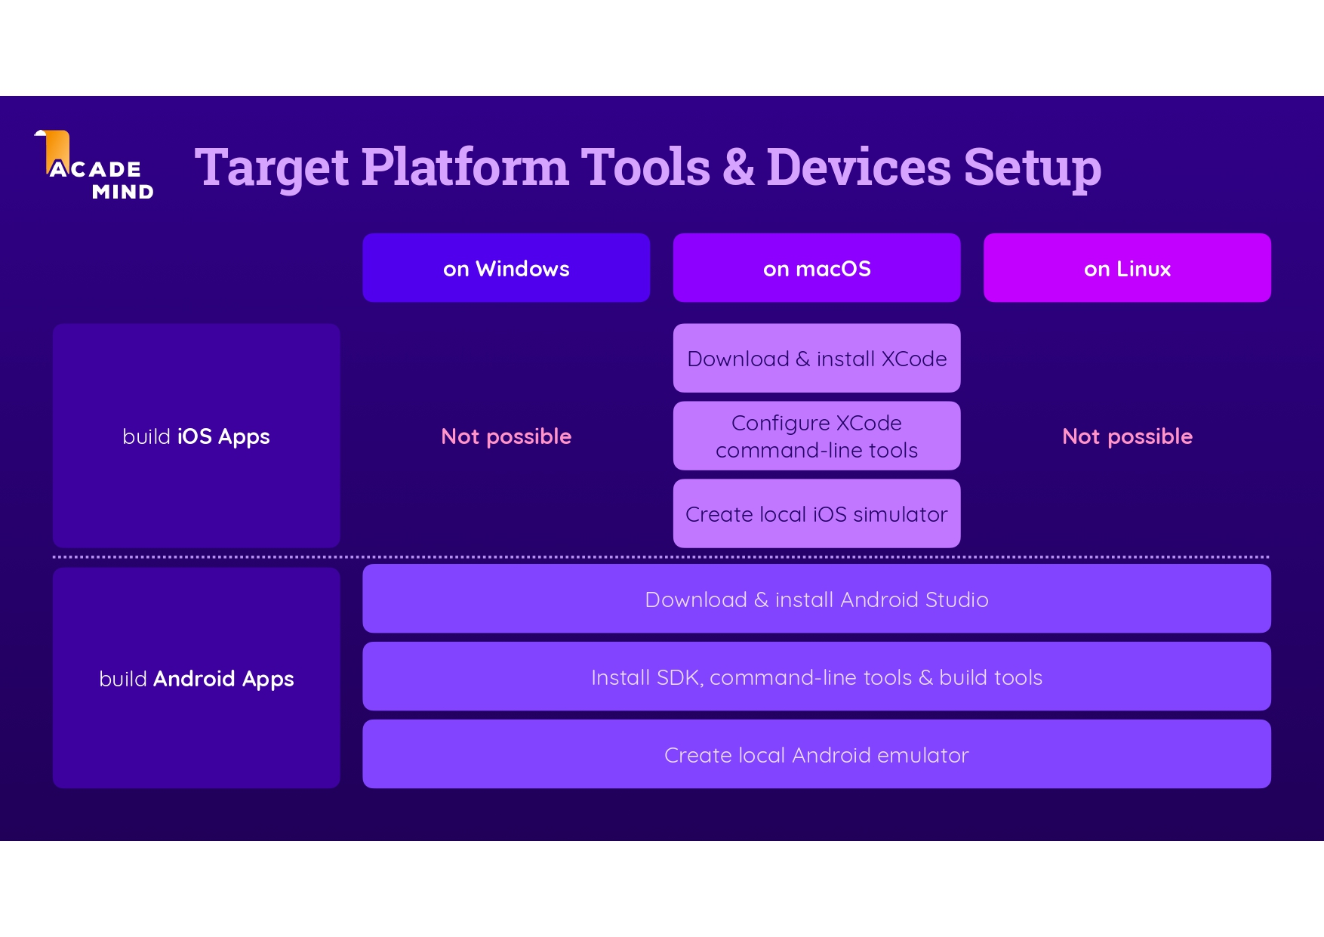

Slide 34
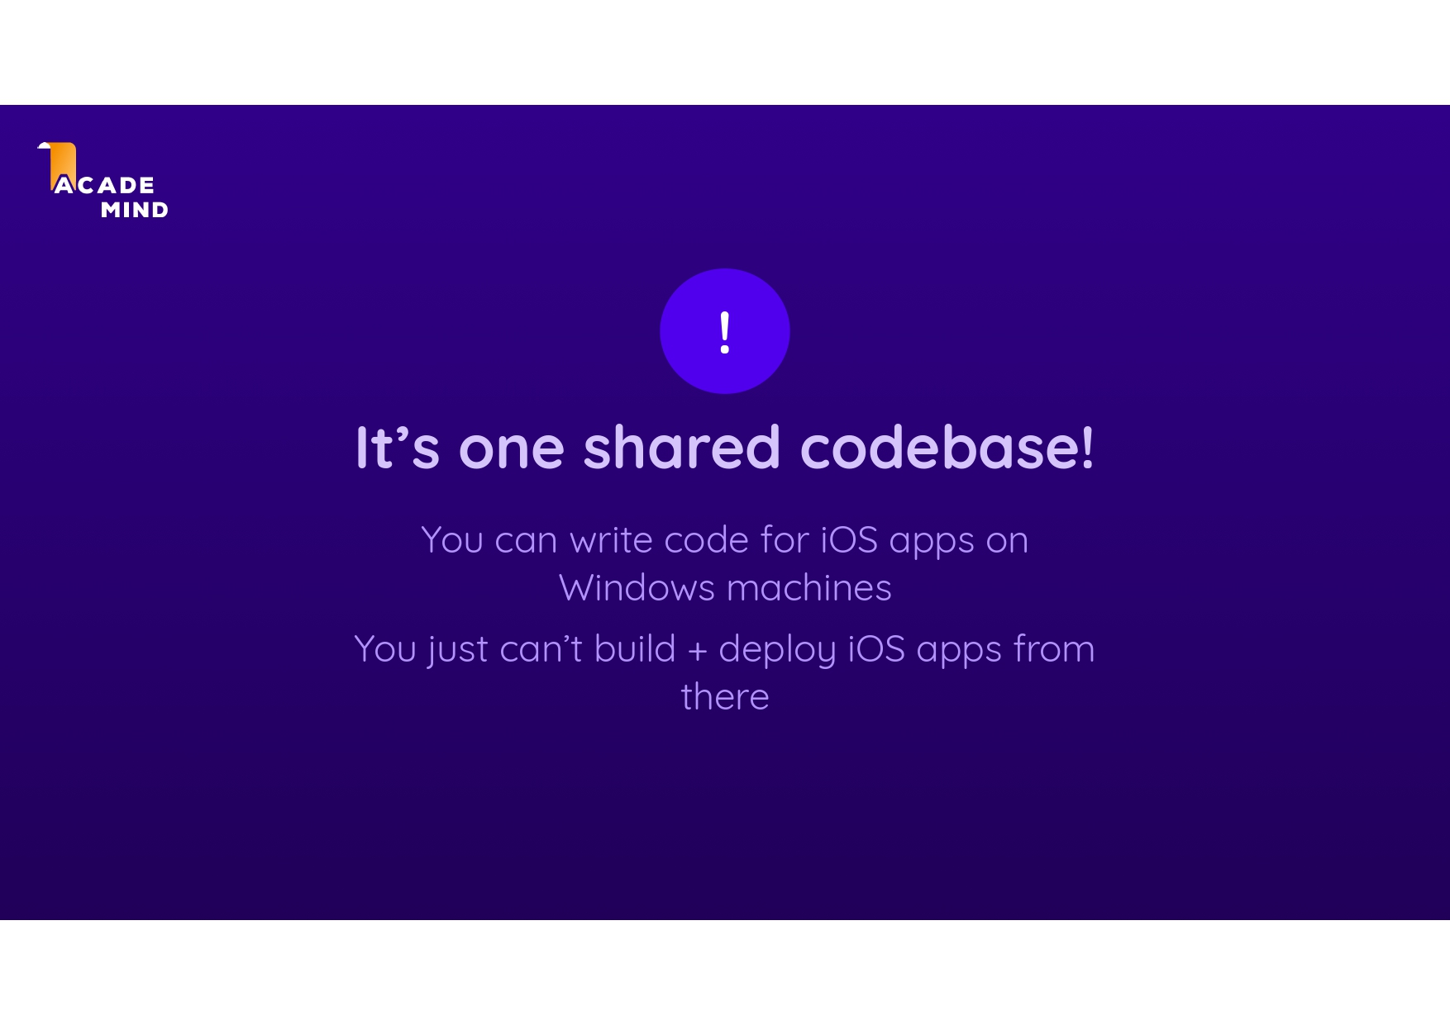

Slide 35
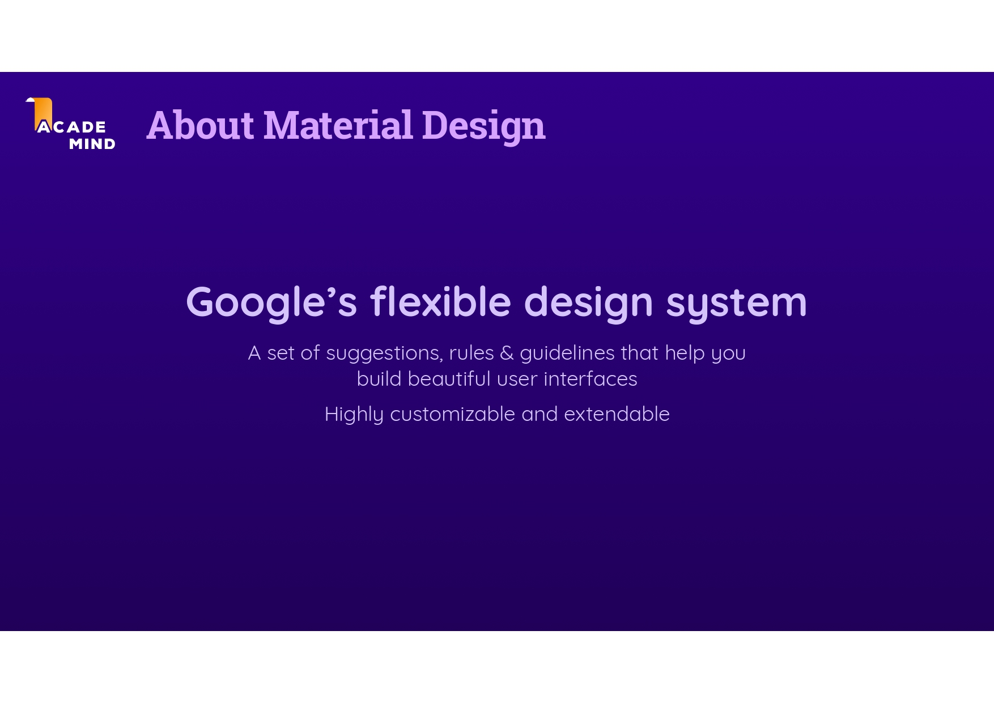

Slide 36
Resources
Flutter & Dart - The Complete Guide [2023 Edition]
https://www.udemy.com/share/101rfI3@-qrep4sWfrhI6kzuJk8j7zX_IQXar8VLQ8LdgAtMERpT_A8toZwYOFQ3yioo404mdg==/
The Complete Flutter Development Bootcamp with Dart
https://www.udemy.com/share/101WB63@FmdLPpqm4OwgB1CpmPEbSs72yIbn_pMA4RH3zhXczQb_Ce8sZiTwOoR7hLyfY3NjZg==/

Slide 37
Youtube Channels
https://www.youtube.com/@flutterdev
https://www.youtube.com/@VandadNP
https://www.youtube.com/@RivaanRanawat
https://www.youtube.com/@FlutterMapp

